Slide 1
Data Science Project Presentation
By: Omar Al-Gailani

Slide 2
Background for fictional setting
Gamer Move Inc. is on its last knees
Numerous failed releases have left their financial situation and their reputation in the gutter
One bad game away from bankruptcy
It is up to me to help!
But, they don’t know where to start…

Slide 3
Problem:
They don’t know what kind of games to make!

Slide 4
Why this problem?
Better insight into the video game industry
Compare different kinds of successful video games
Better understanding of what can potentially make or break a game

Slide 5

Why do companies make games?
It’s their passion
A fun creative medium (art, TV, etc.)
And most importantly of all…
Money

Slide 6
How am I gonna figure this out?

Slide 7
What makes a good game?
Two ways a game can be considered “successful”
Critically
Financially
Critically: High rating scores, usually from both critics and users
Financially: Had lots of sales, and made a lot of money by selling a lot of copies

Slide 8
What did I do?
Coded everything on Jupyter Notebook
Utilized two different tables of data
One with Ratings
One with Sales
Merged the two data sets by both the game name and platform through an inner join
Helps with accuracy, and the extra inner join with the platform avoids any weird repeats (from earlier testing)

Slide 9
Data Visualizations

Slide 10
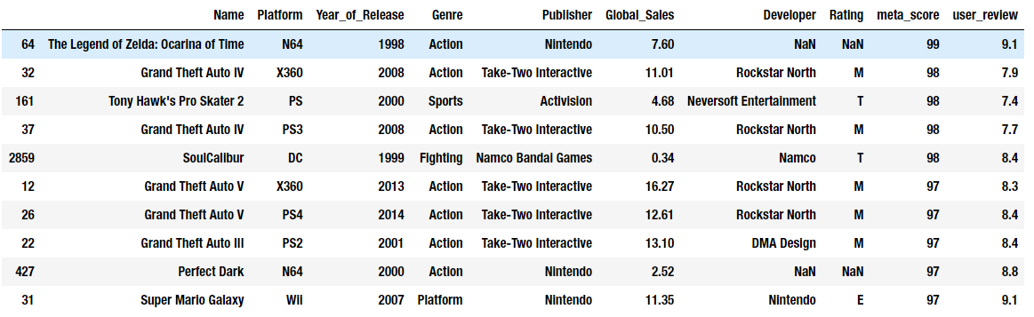
Top 10 Highest Critic-Rated Games
Grand Theft Auto games always sell over 10 million copies
97+ Meta rating
7 of the top 10 games are action games

Slide 11
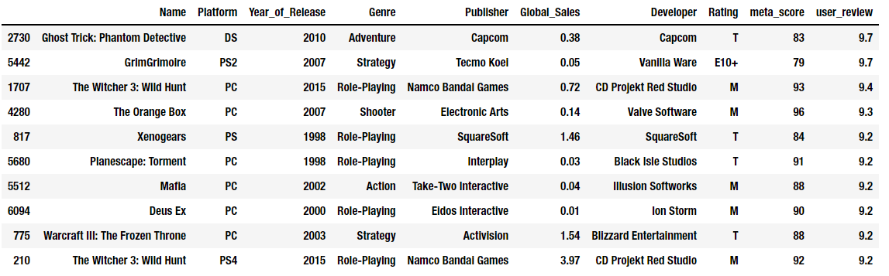
Top 10 Highest User-Rated Games
Witcher 3 holds two spots for both the PC and PS4 release.
7 of the top 10 games are on PC
Global Sales are rather low, with only 3 of the 10 games reaching past 1 million sales

Slide 12
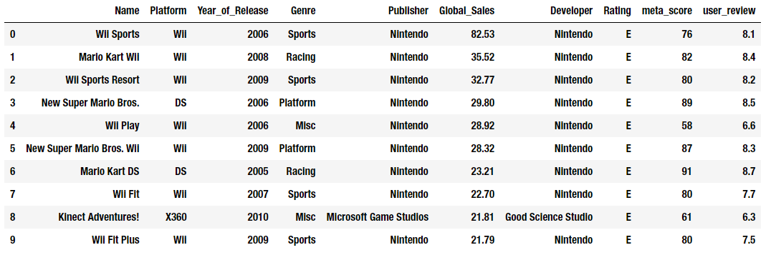
Top 10 Most Sold Games
Except for one, all of these games are Nintendo
All of these games are rated E
Wider audience

Slide 13
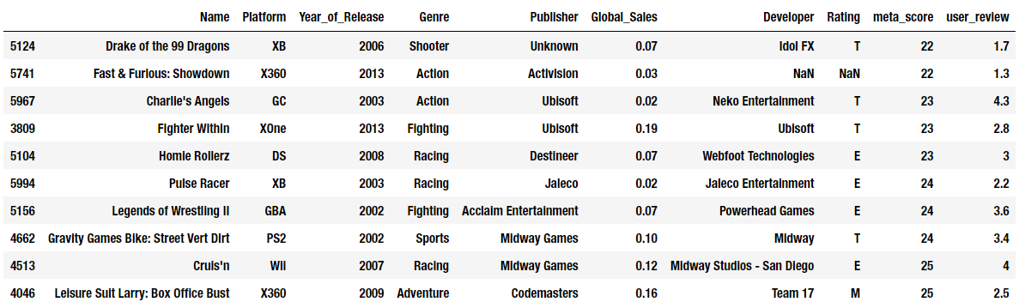
Top 10 Worst Games by Critic Score

Slide 14
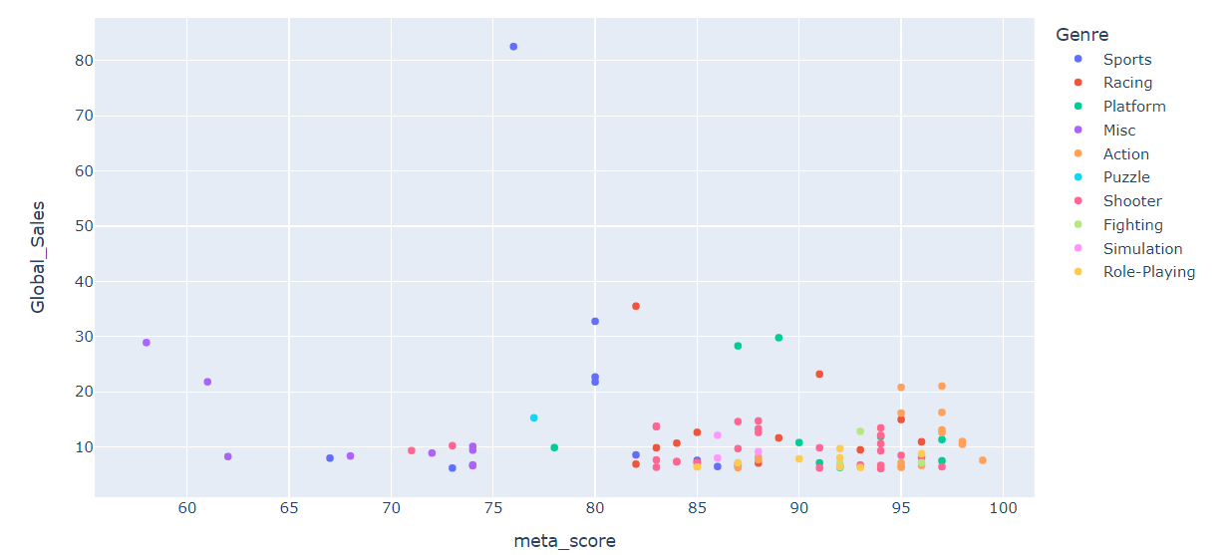
Top 100 Games Scatterplot

Slide 15
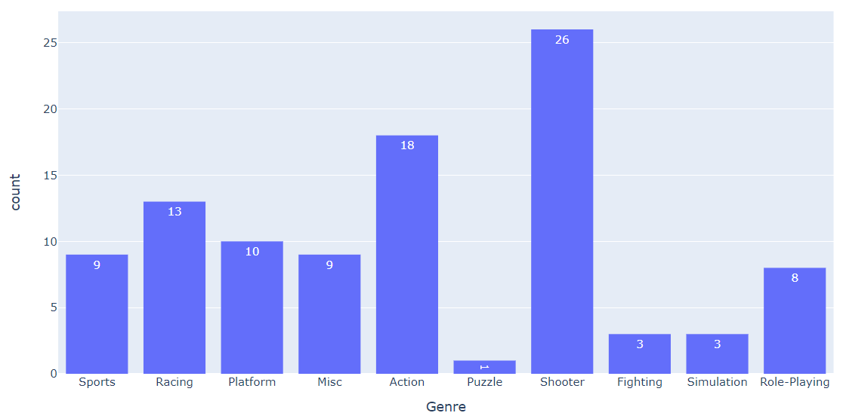
Top 100 Games Count by Genre

Slide 16
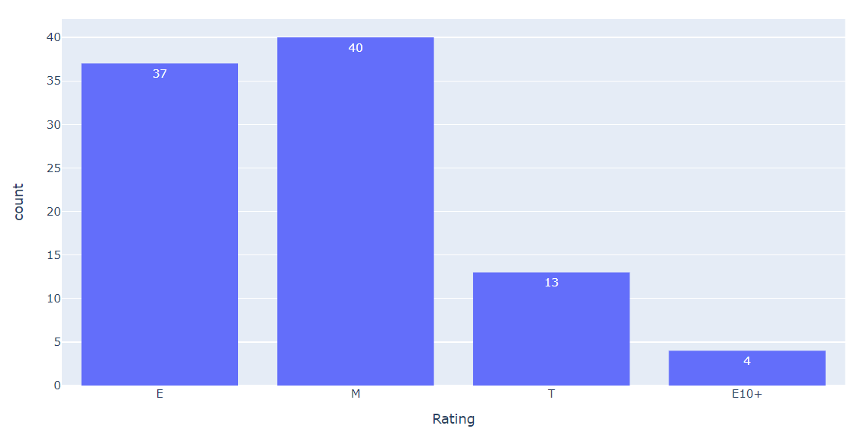
Top 100 Games by ESRB Rating

Slide 17
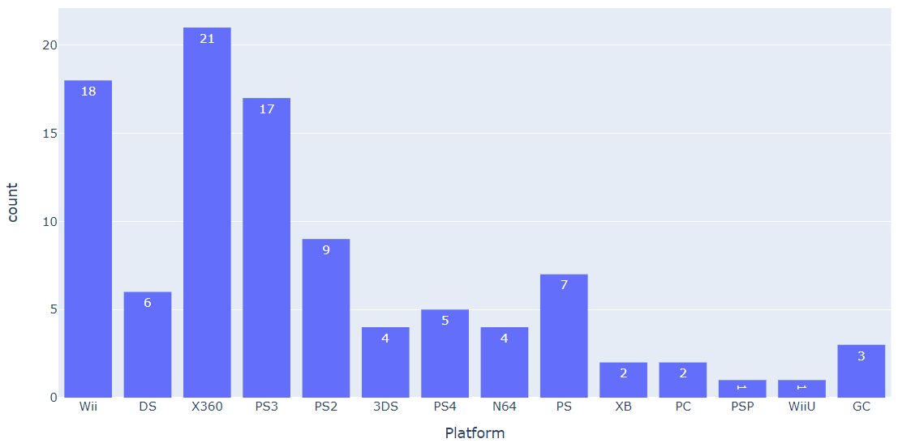
Top 100 Games by Platform

Slide 18
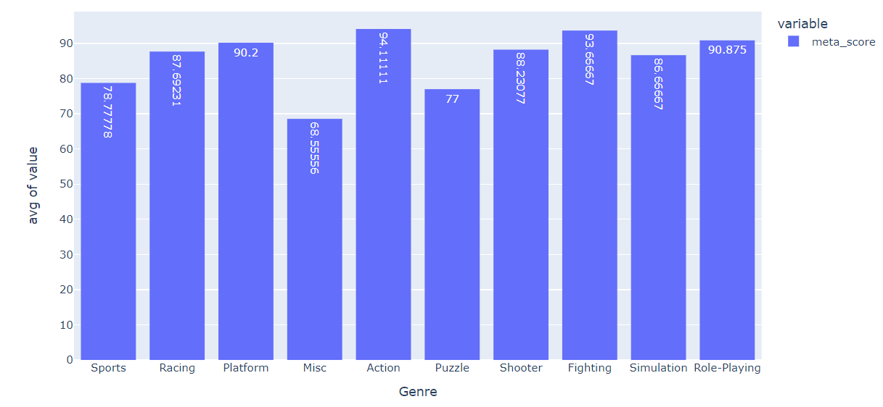
Top 100 Games Average Critic Score by Genre

Slide 19
Insights

Slide 20
Same name, different game
Some games had repeated entries
Different release platforms (e.g. Xbox, PS3, etc.)
Different release dates
Different publishers
Could lead to different ratings as well

Slide 21
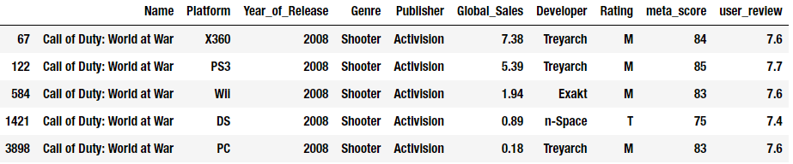
Example 1: Call of Duty: World At War
Different developer for both the Wii and the DS port
Did an okay job, considering the time period and hardware limitations in 2008

Slide 22
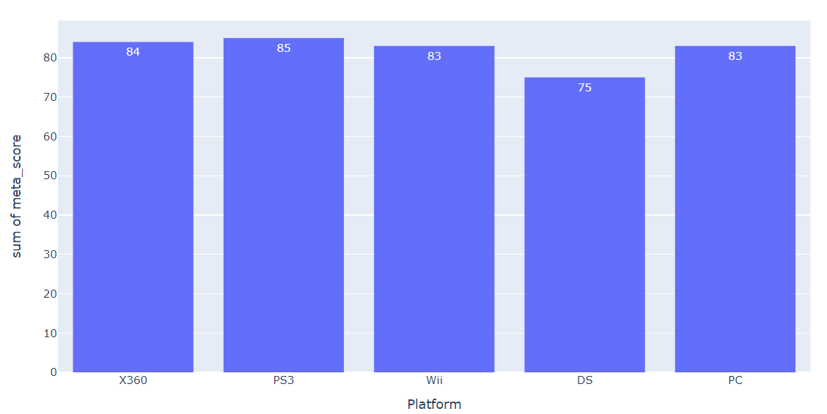
Example 1: Call of Duty: World At War (cont.)

Slide 23
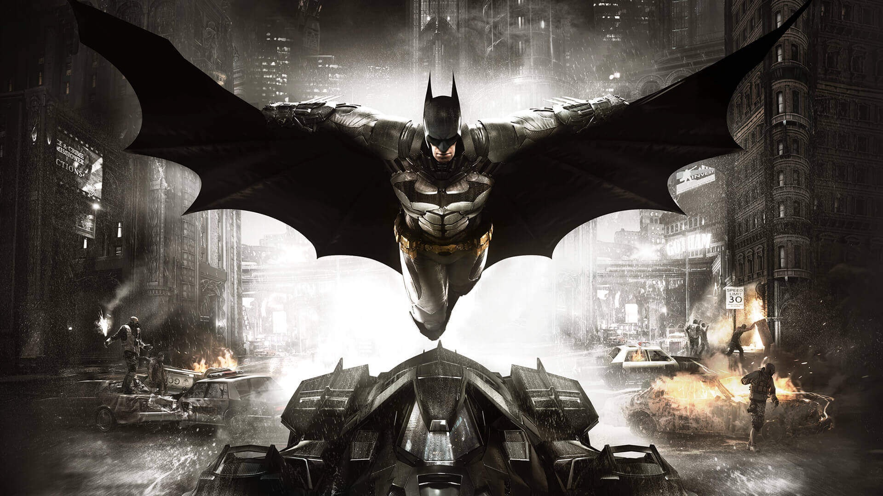
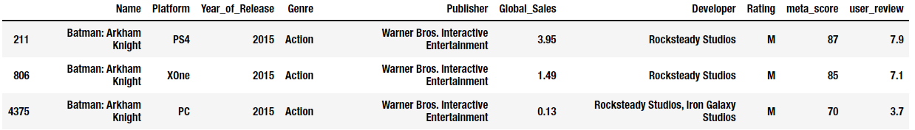
Example 2: Batman: Arkham Knight
Overall great game on Xbox One and PS4
Different developer in charge of PC port
Didn’t do well…

Slide 24

Quick Example…

Slide 25
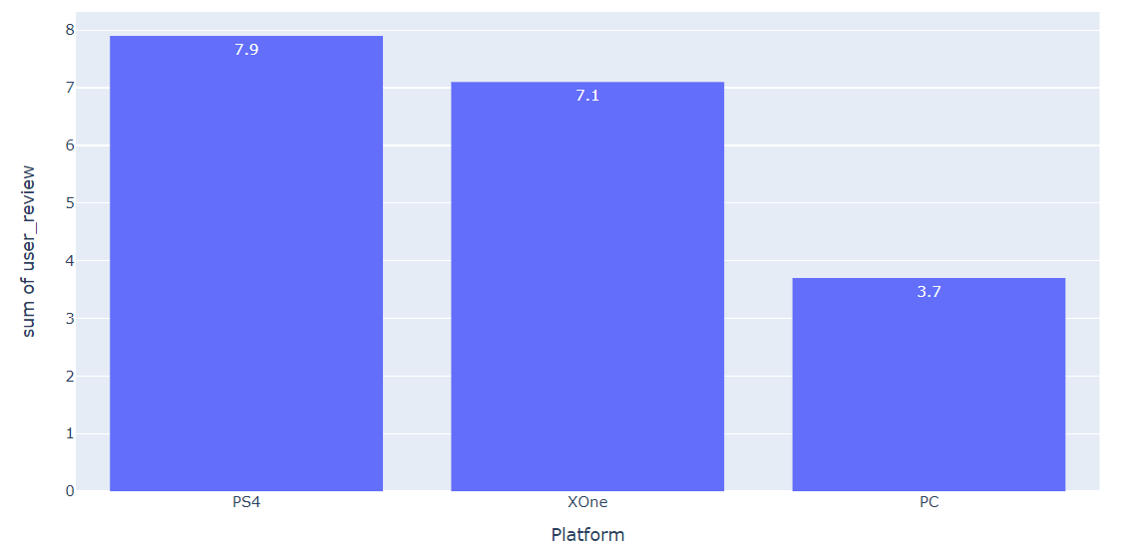
Example 2: Batman: Arkham Knight (cont.)

Slide 26
Top 100 Overview
Shooter and Action games dominate the list
Combined total of 44 games between these two genres
Near even split between E rated games and M rated games (E 37 - 40 M)
E - rated game examples
Wii Sports
Mario Kart Wii
New Super Mario Bros.
M-rated game examples
Gears of War 3
Grand Theft Auto V
Call of Duty: Black Ops

Slide 27
How is a game successful?
(or rather, how can we measure a game’s success)
Use machine learning to figure it out
Decision Tree
Made a rudimentary rule list to determine a game’s success
Requirements
If M rated, must get either a Meta_score of 80 or sold 10 million copies
If rated anything else, must get either a Meta_score of 75 or sold 15 million copies
Linear regression
Used leftover data declared from the decision tree for this method

Slide 28
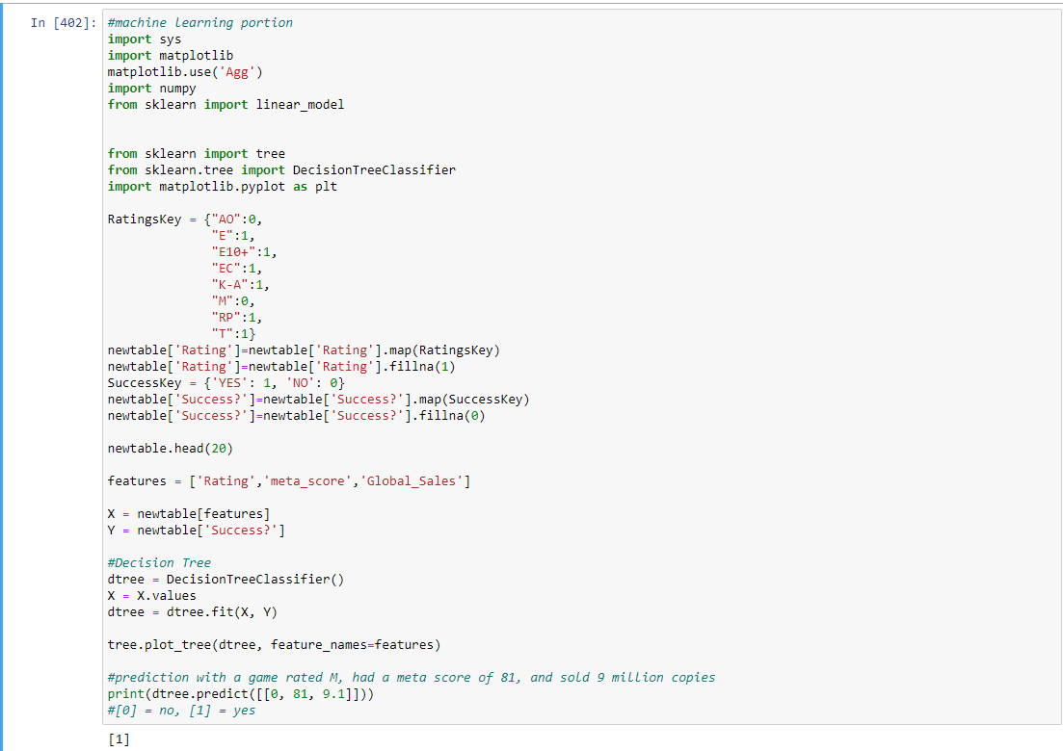
Decision Tree Predictor

Slide 29
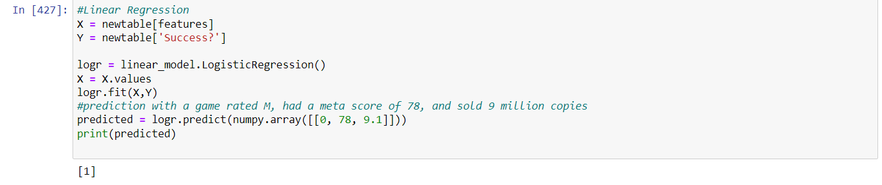
Linear Regression Predictor

Slide 30
Machine Learning Results
Both had accurate results
Strangely had 100% accuracy
Likely due to very simple rules for success
Worked without issue
Albeit after a lot of work

Slide 31
Recommendations

Slide 32
Option 1: Create a E-rated game
Platform: Any Nintendo-owned platform (Wii, DS, etc.)
Genre: Action, Fighting, Platforming
Reasoning:
Top 10 games in sales are all rated E
Majority of top 100 games are rated E
Pros
E rating opens game up to huge audience including children and adults
Safe bet with little risk due to large amount of sales with E-Rated games
Cons
Hard to break into the market
Nintendo dominating the market
Strange consoles to work on, like Wii or DS

Slide 33
Option 2: Create a critically acclaimed Action/Shooter game
Platform: Xbox 360 or PlayStation 3
Rating: M
Reasoning:
Most of the top 100 games are on the Xbox
Genre among highest rated in top 100
Action at 94.1, Shooter at 88.2
Pros
Create reputation as a prestigious game company
Loyal fanbase
Cons
Much smaller audience with the M rating
Expensive to produce
May be subject to scrutiny from the media
(Video Games are Violent, blah blah blah)

Slide 34
Future Work

Slide 35
Future Work
Next steps?
Make and publish the damn game
Does the problem need to be revisited?
Yes, because industry is constantly evolving
Crossplay
Microtransactions
Live-service games
Can the project be improved with more work?
Yeah
Could refine the data even more and go more in-depth about some of the examples
Could have refined the Machine Learning components
If I were given more time and resources, is there anything that could be done better?
Yes.
More up-to-date data for the next generation of games (2018-2021)
Would’ve loved to analyze Cyberpunk 2077 on different platforms
More precise ratings and scores
Maybe get data from Steam as well

